Slide 1
Little Neck Day Program 58-20 Little Neck Parkway Little Neck, NY 11362 T. 718-428-2121
Providing Exceptional Community Hab And Remote Services

Slide 2
Table And Content
Day Program
Remote Services
Community Hab

Slide 3
Day Program At Little Neck
Mon-Fri 8am-4pm

Slide 4
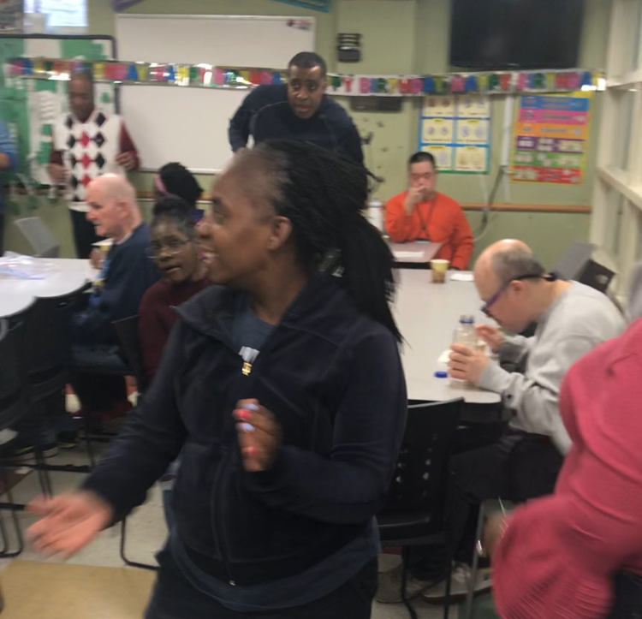
Day Program At Little Neck
Day Program provides Prevocational, Vocational and job readiness training for those who will seek employment in the future. Each day, our individuals volunteer at various worksites that supports his or her valued outcomes within the workplace. An outcome related to a person’s likes, interest, and desires will be included into the Life Plan.
Everyone at Little Neck loves to DANCE and PARTY
We celebrate Birthdays, Holidays, Anniversaries, and any special occasion that will give us a reason to smile and dance.

Slide 5
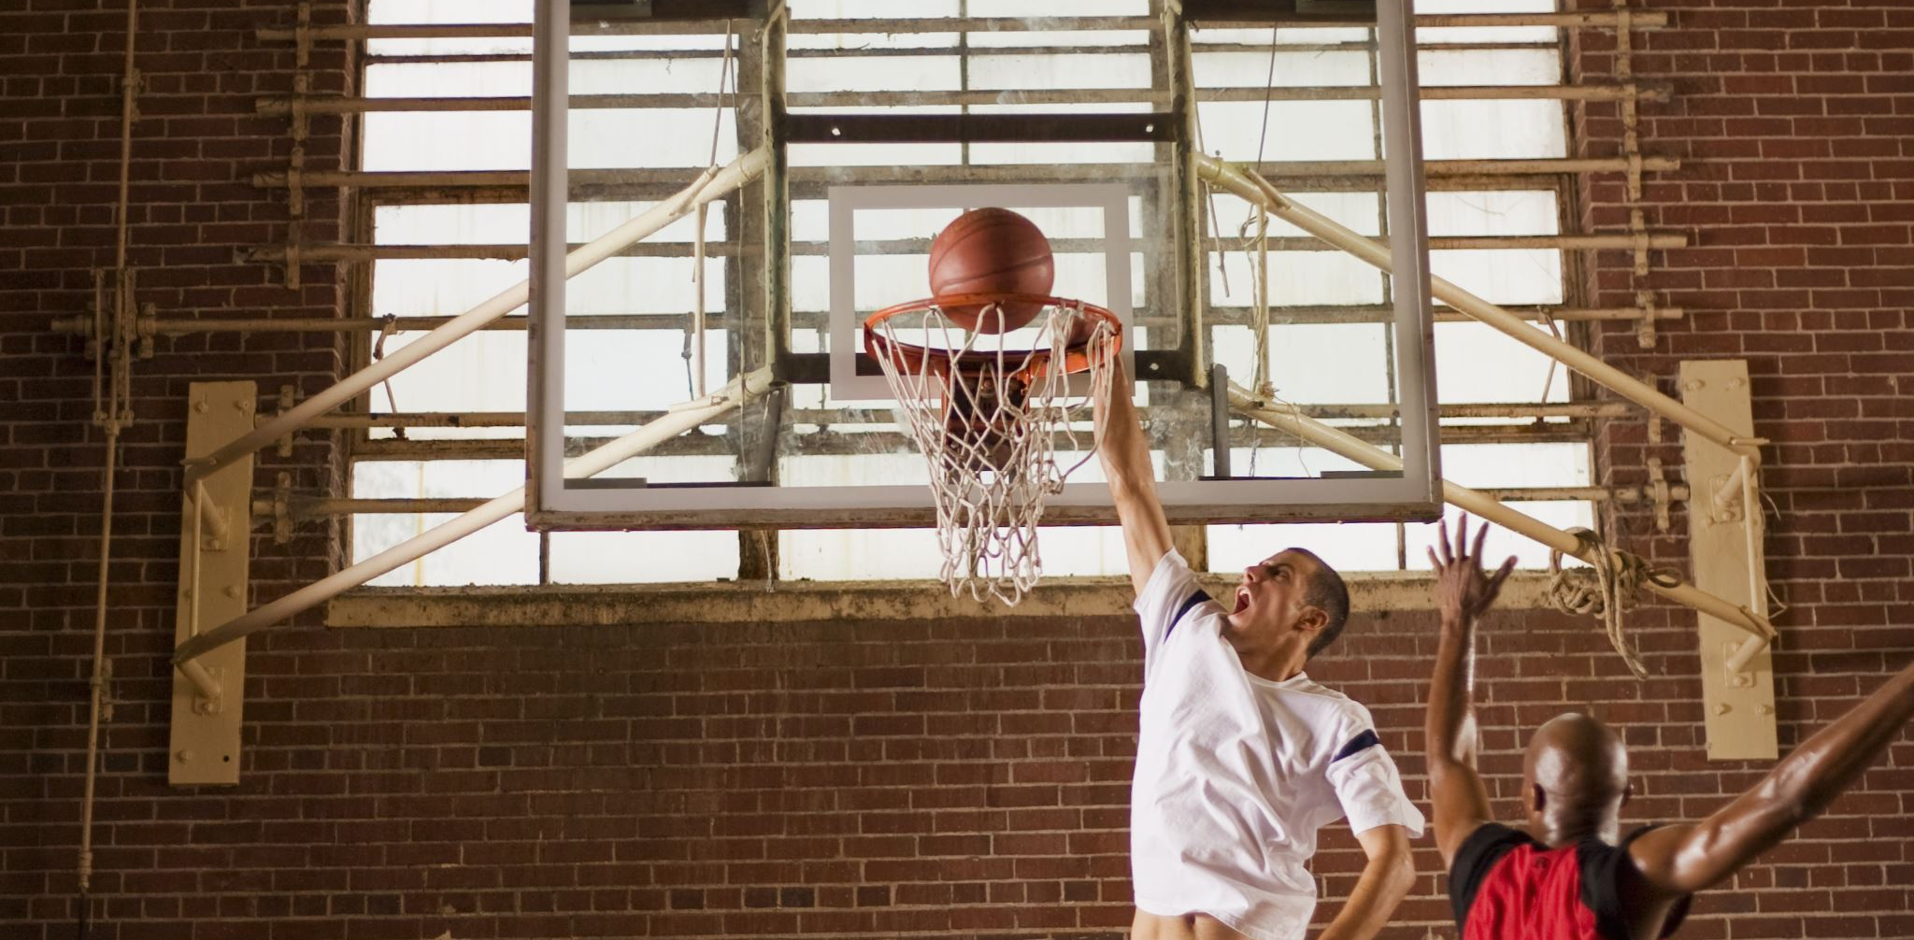
Each week we offer a variety of activities that our individuals can choose to participate in such as:
Basketball
Yoga
Bowling every Friday
Membership To YMCA
Beauty Club
Comic Book Club
Snack Attack
Computer Time
Dog Therapy

Slide 6
*COMMUNITY
*HABILITATION
Our staff assist our individuals inside of their homes with daily living skills, social skills, preparing small meals, and interacting within the community.
During each visit, staff and individuals can enjoy recreation outings of their choice, learn traveling training, gain money management skills, and building relationships within their community.

Slide 7
Since the height of the COVID-19 Pandemic, our Day Hab location has been temporary closed. Over the last seven months, Little Neck has been offering Remote Services to individuals enrolled in Day Program.
Remote Services
Our individuals sign in online to watch and participate in ADAPT Community Network radio show from 10am-11am, interact with peers from day program, attend virtual field trips, engage in activities such as Bingo, Hangman, arts and crafts and many more

Slide 8
Even though we are temporary closed, we are STILL practicing all safety and health regulations.

Slide 9
We Are A Family
Even though our lives have changed, Little Neck Day HAb is STILL here to support EVERYONE!

