Slide 1
Park Avenue Day Program

Slide 2
Contents
Introduction of program
Creating individualized services
What our services look like
Contact information

Slide 3
Introduction
Human First Inc none-profit organization that has been supporting people with a developmentally disability in the communities through out New York City and Long Island since 2001.
The Park Avenue day program provides exemplary services to individuals with varying needs, particularly the underserved.
The day program successfully fosters the health and safety of all individuals in a nurturing, respectful environments. Embracing a person-centered philosophy in all services, while continually evolving to meet the needs of individuals.
The program has a fully handicap accessible program space which accommodates wheelchairs.

Slide 4
CREATING A PLAN
Each person who is served has their own unique plan based on their wants and needs.
Each Staff Action Plan is created using a person-centered plan approach.

Slide 5
Key Offerings But not limited to
Speech Therapy (Once a week)
Psychotherapy (Once a week)
Occupational Therapy (1x week)
Travel Training Program
Gym Membership & Participation
Activities of daily living (ADL)
Volunteer sites
Recreational activities.

Slide 6
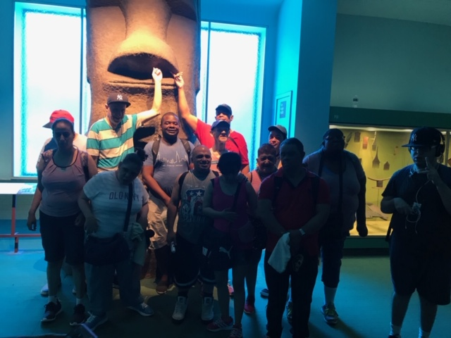
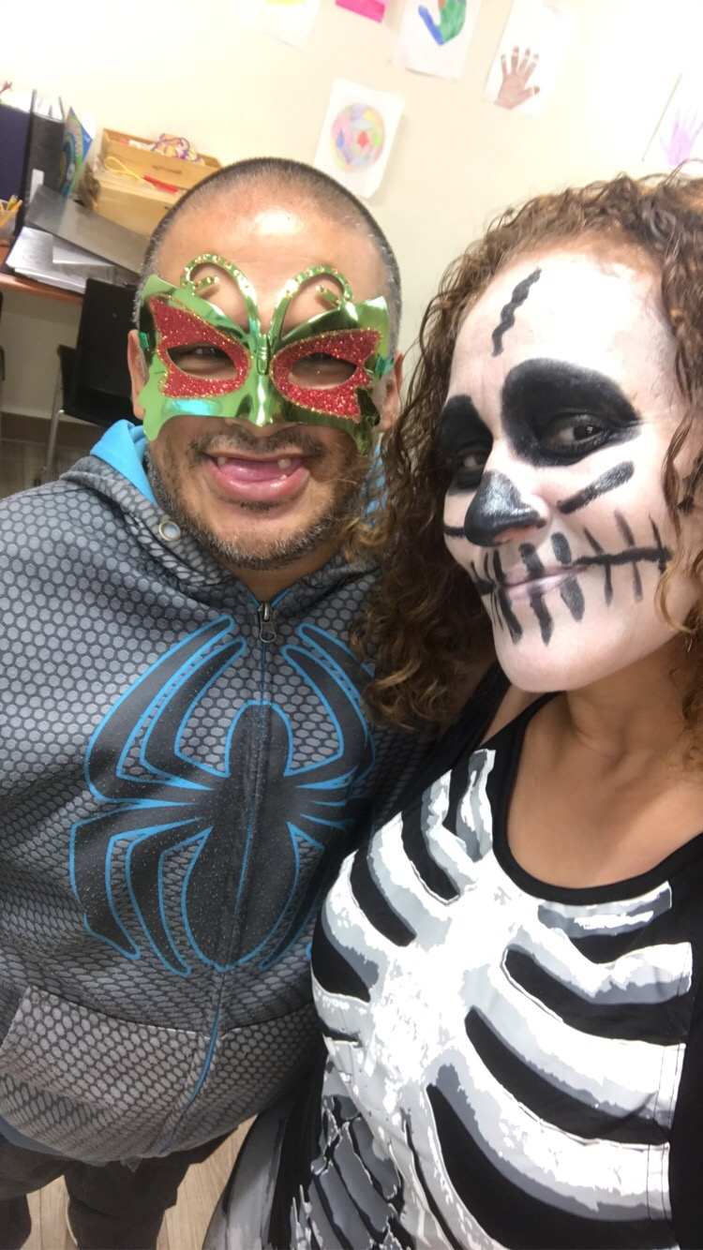
Park Avenue Day program “This is us”

Slide 7
Yoga- weekly by a professional instructor Arts and Crafts Community Gardening during the warm seasons Outings throughout the boroughs Birthday/Holiday celebrations Volunteer opportunities Academic/Education Skills Catch and release Fishing activities during warm season Sport tournaments
DAY PROGRAM Activities

Slide 8
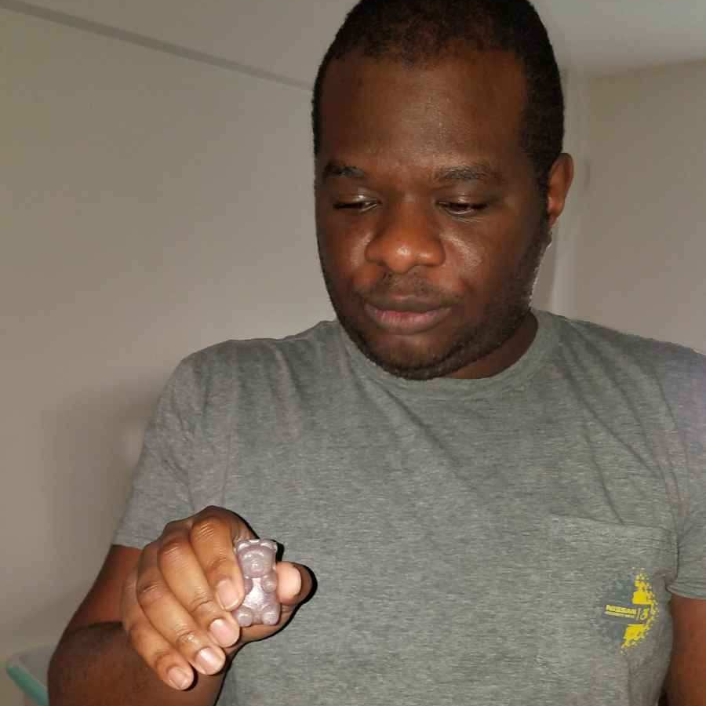
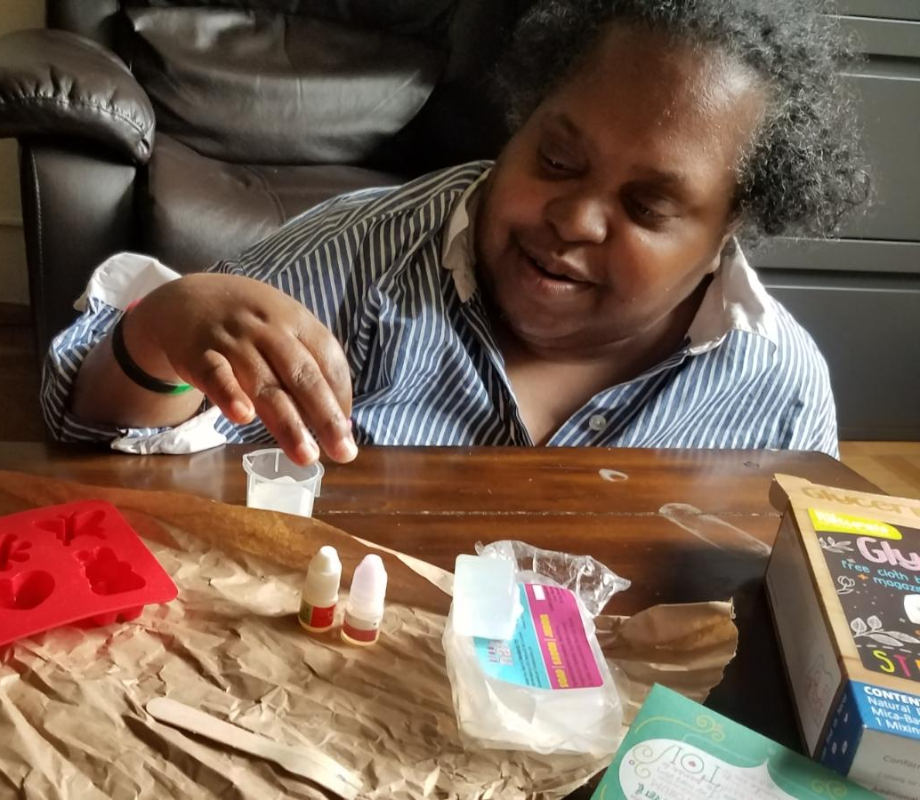
Arts and Crafts Soap Making Activity.

Slide 9
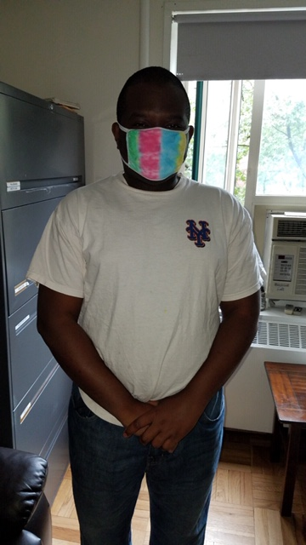
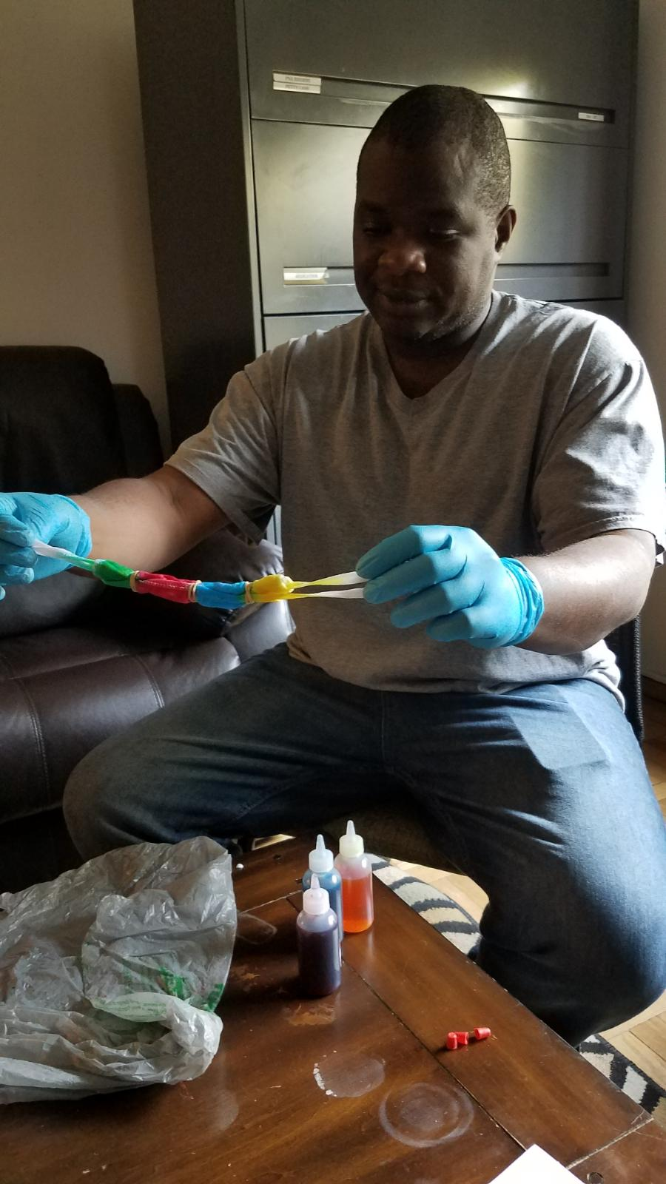
Tie Dye Mask Making

Slide 10
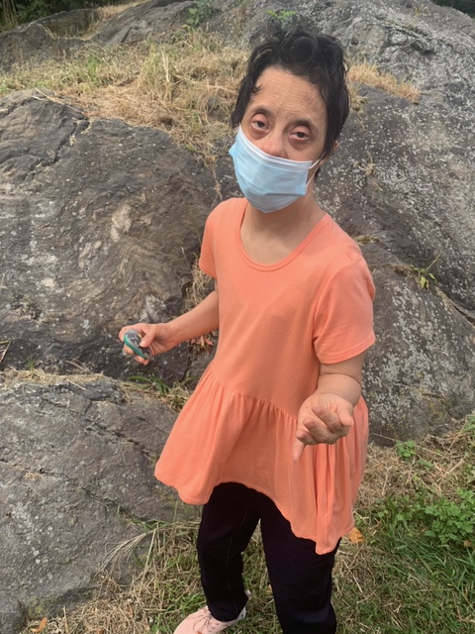
Finding Hidden Gems in Central park
Notes:
Consider talking about:
State Funding Systems
Maintenance of Effort

Slide 11
Working Remotely
Park Avenue day program offers remote services.
A remote service plan is created to tailor the needs of the person being served.
Remote service may be provided via many different platforms. Zoom, Facetime, Teams, Google duo, etc.

Slide 12
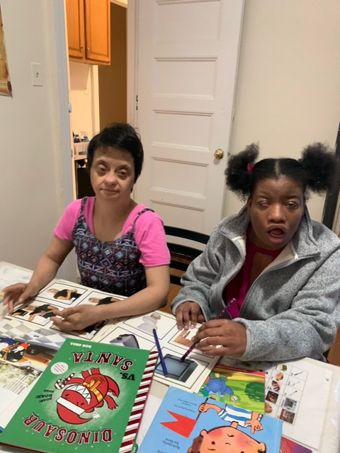
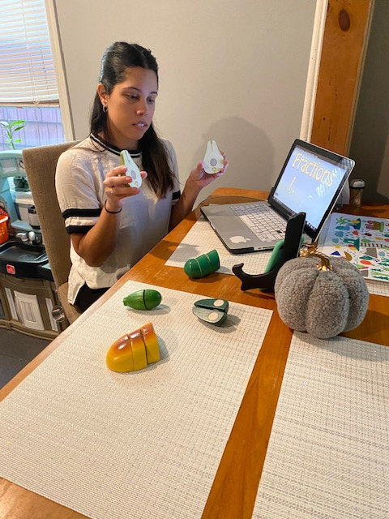
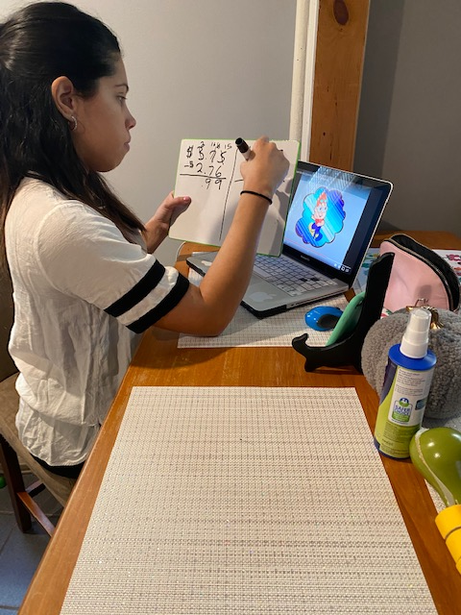
Academic skills Picture1 -working in-person on academic skills Picture 2 and 3- remote services being provided.
Notes:
Consider talking about:
The referral
The evaluation
Classification

Slide 13
TESTIMONIAL
“Every day my daughter is more than happy to attend the day program. I am greatly appreciated for the services; all of the staffs are courtesy and kind. The program keeps me informed of any changes about my daughter during the program hours such as food and/or behavior. For transportation services, I do not have any complain/issue”
-Mrs. Rita Hidalgo, Parent of Participant. (Translated from Spanish)

Slide 14
Contact Information
Human First INC
1767 Park Avenue 3Fl.
New York, NY 10035
Marisol Estrada,
Day Program Coordinator
Email: Mestrada@humanfirst.org
Cell: (917)340-6467
Office: (212)480-9169
Khadiduatou Diouf
Kdiouf@humanfirst.org
Cell:(646)771-0410
Office: (212)480-9169
Website, http://www.humanfirst.org

