Slide 1
After School & Saturday Recreation

Slide 2
Bridging Gaps, Building Relationships, Bringing Forth Smiles
Human First’s After School program offers meaningful experiences and community inclusion through a person-centered approach within a positive environment. Among the various services provided are: academic tutoring, health education, money management, art therapy, peer counseling, music therapy, field trips, self-help skills, and much more.

Slide 3
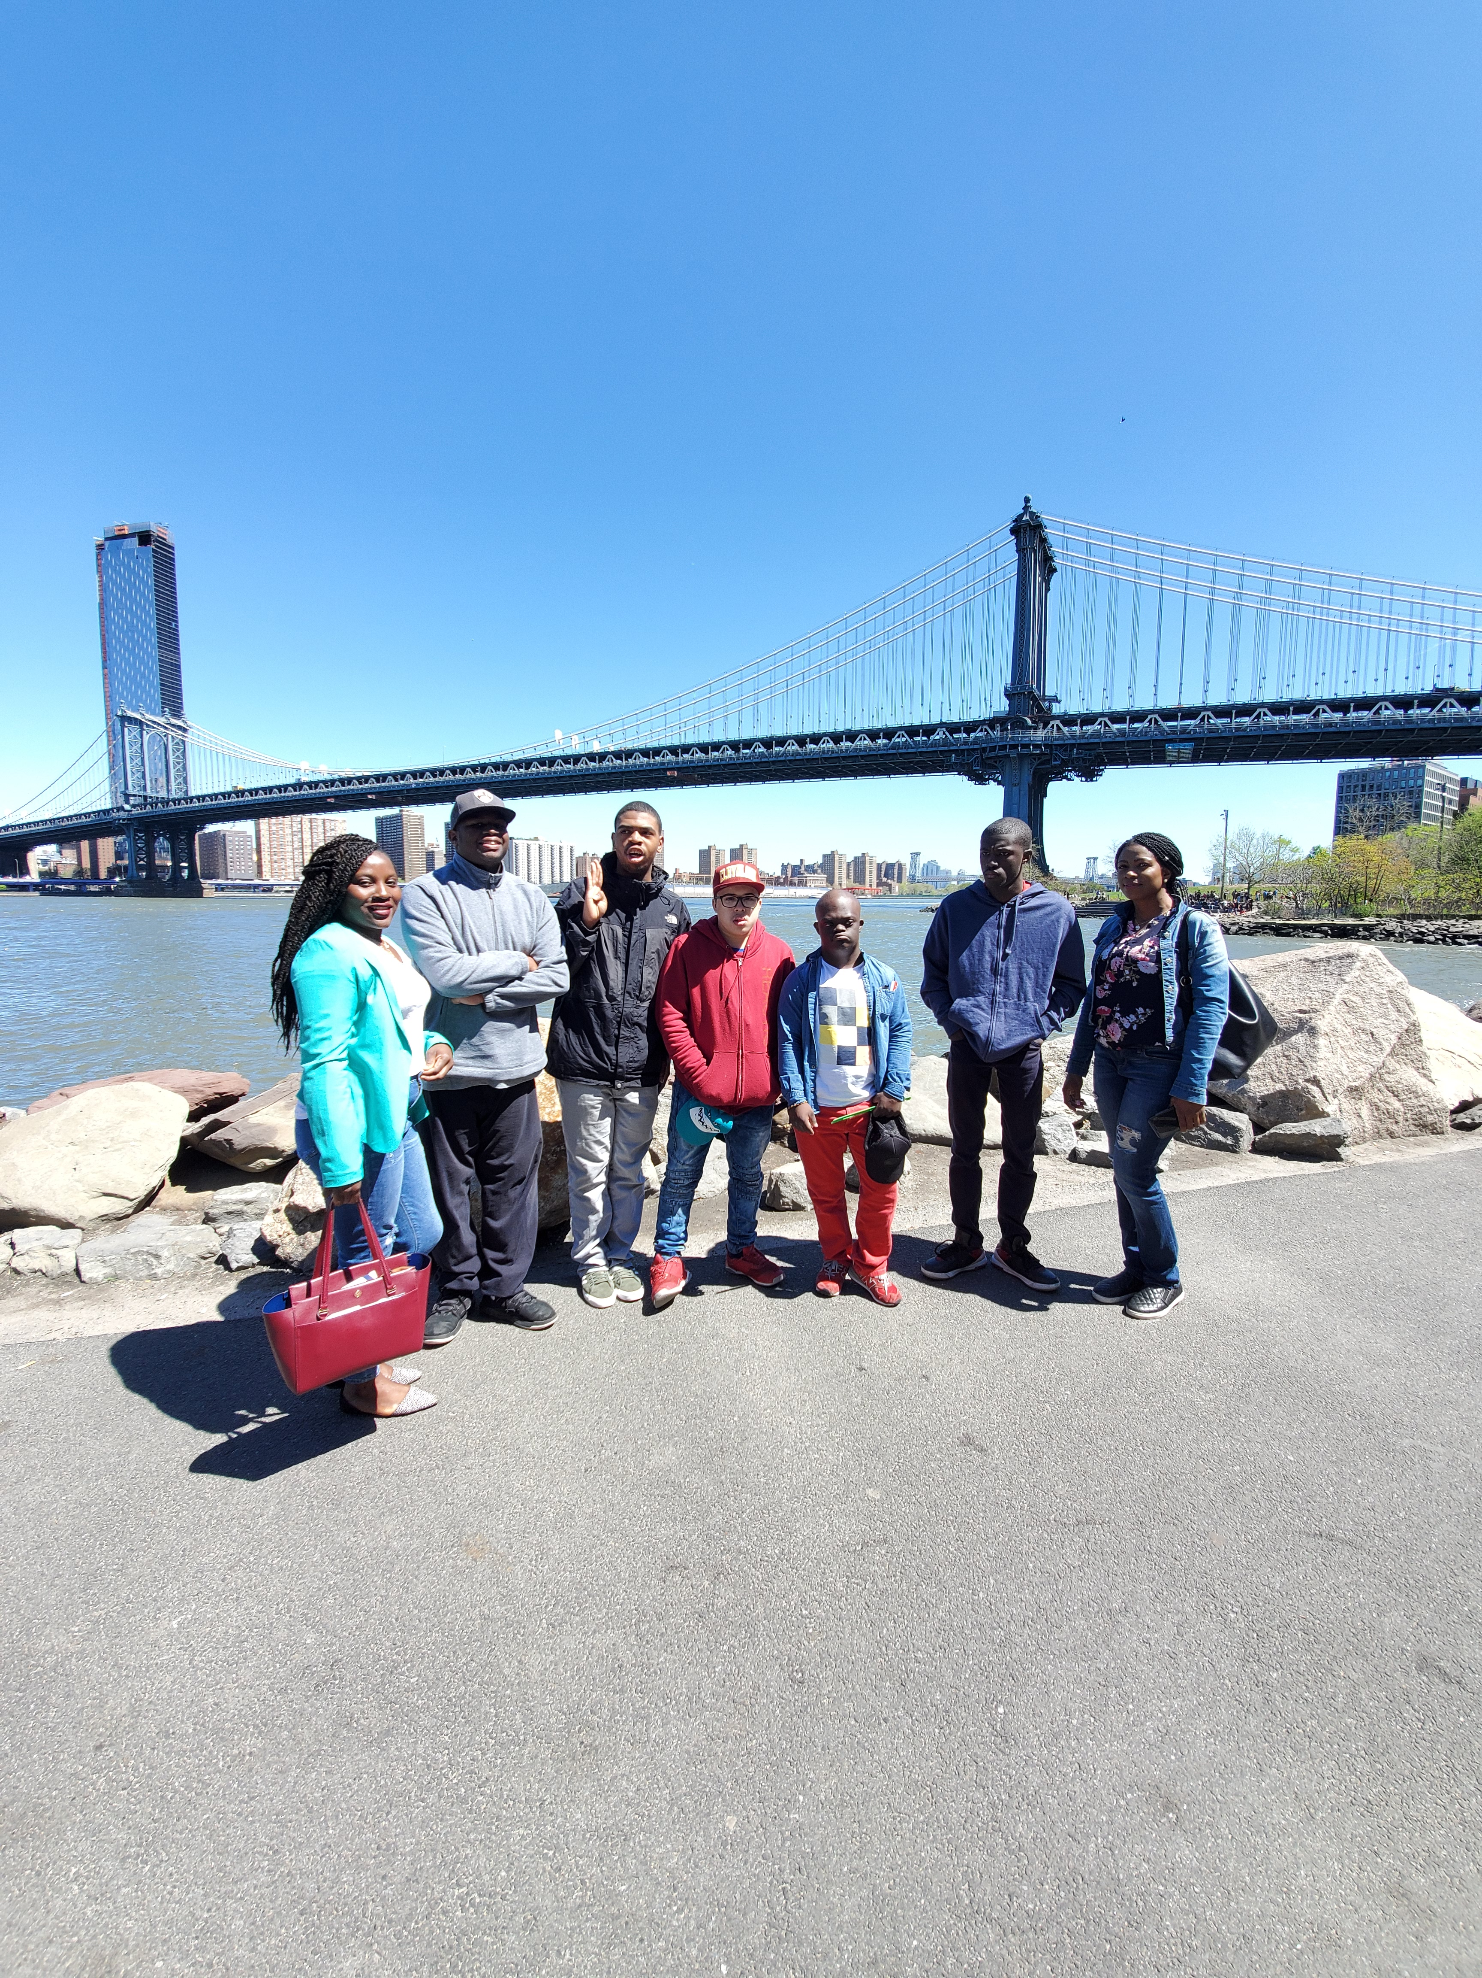
> Program Information
After School Program
Monday thru Friday
3pm to 6pm
&
Saturday Recreational Program
10am-3pm
For children living within Brooklyn
Including a Full Day Program During School Recess
Winter ~ Mid-Winter ~ Spring ~ Summer

Slide 4
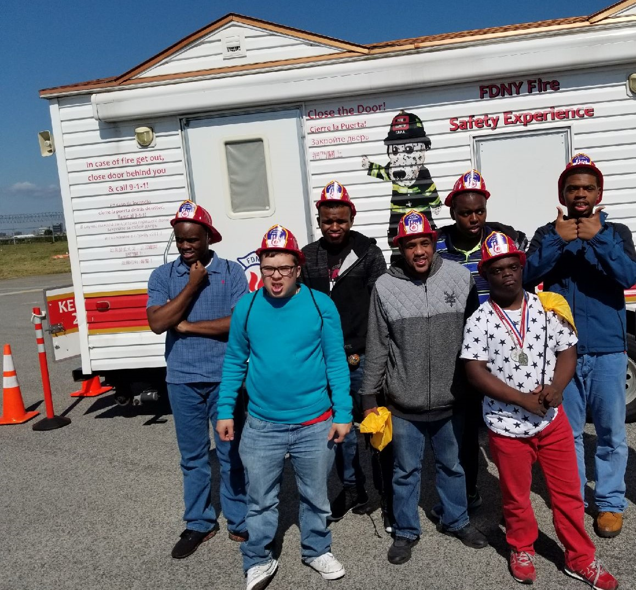
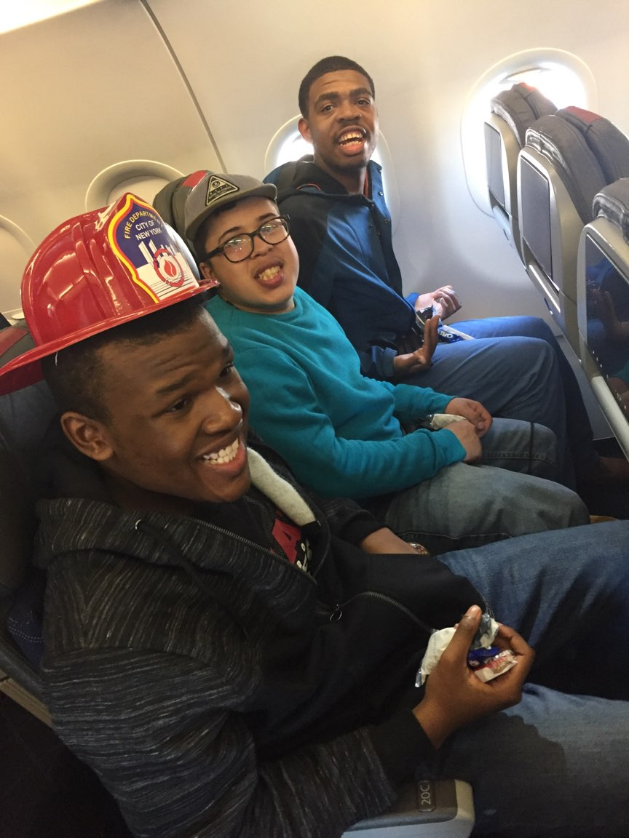
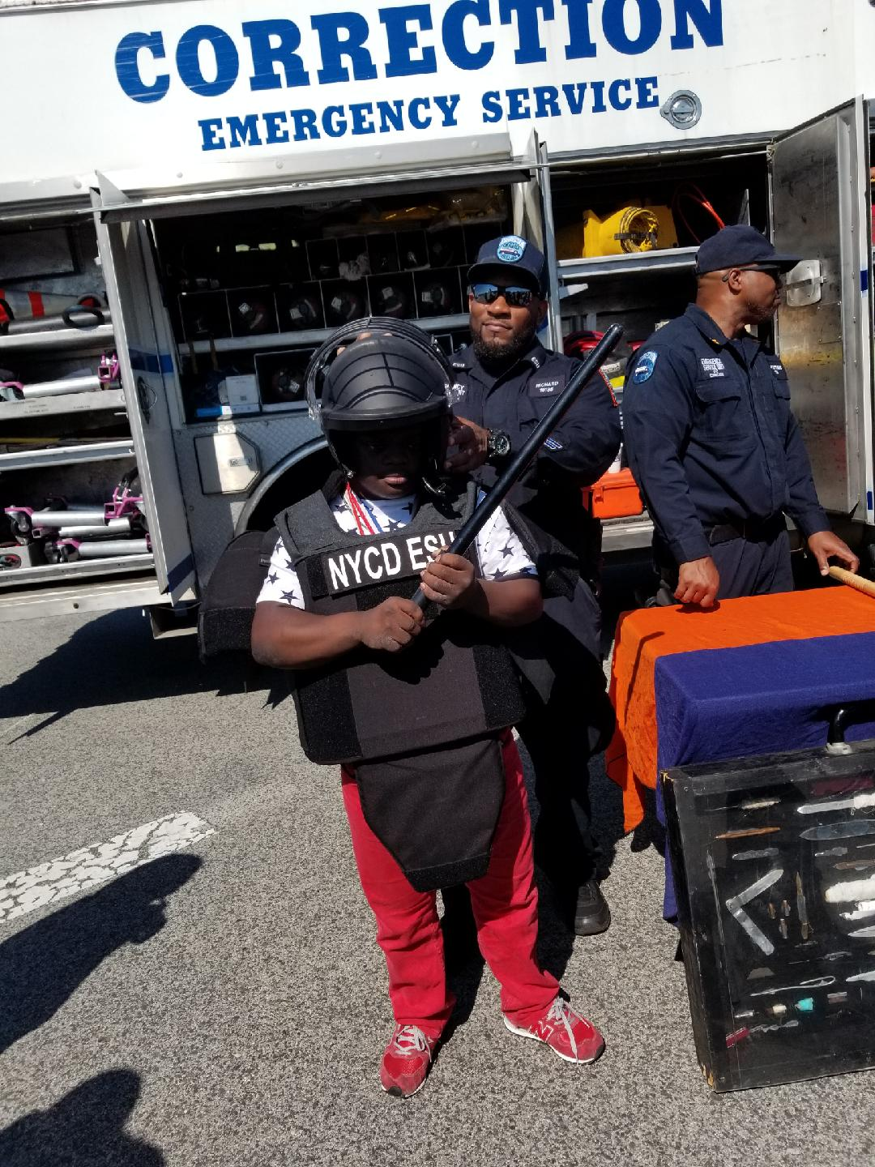
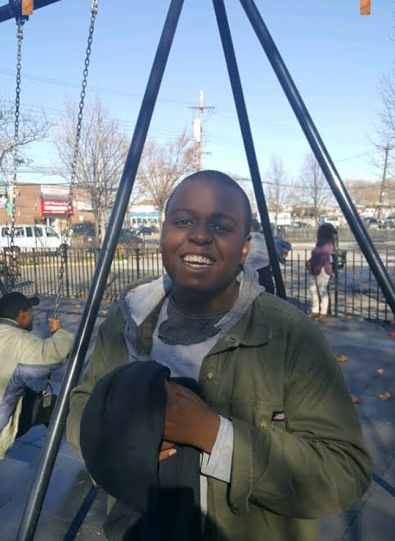
Exploring the Community

Slide 5
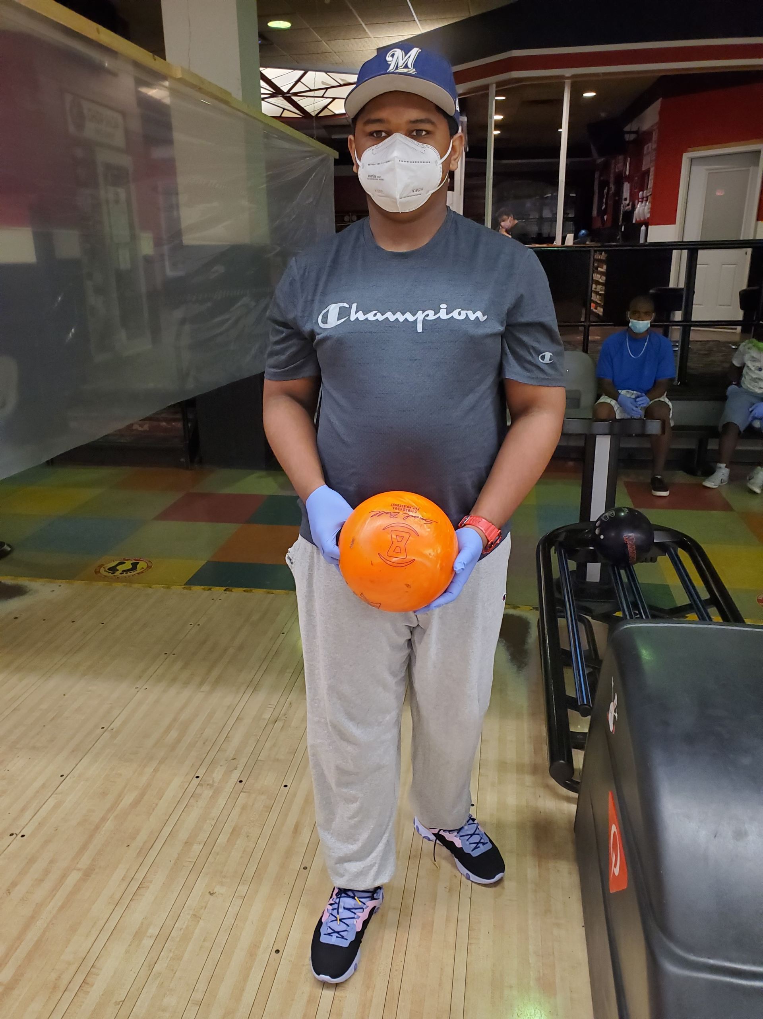
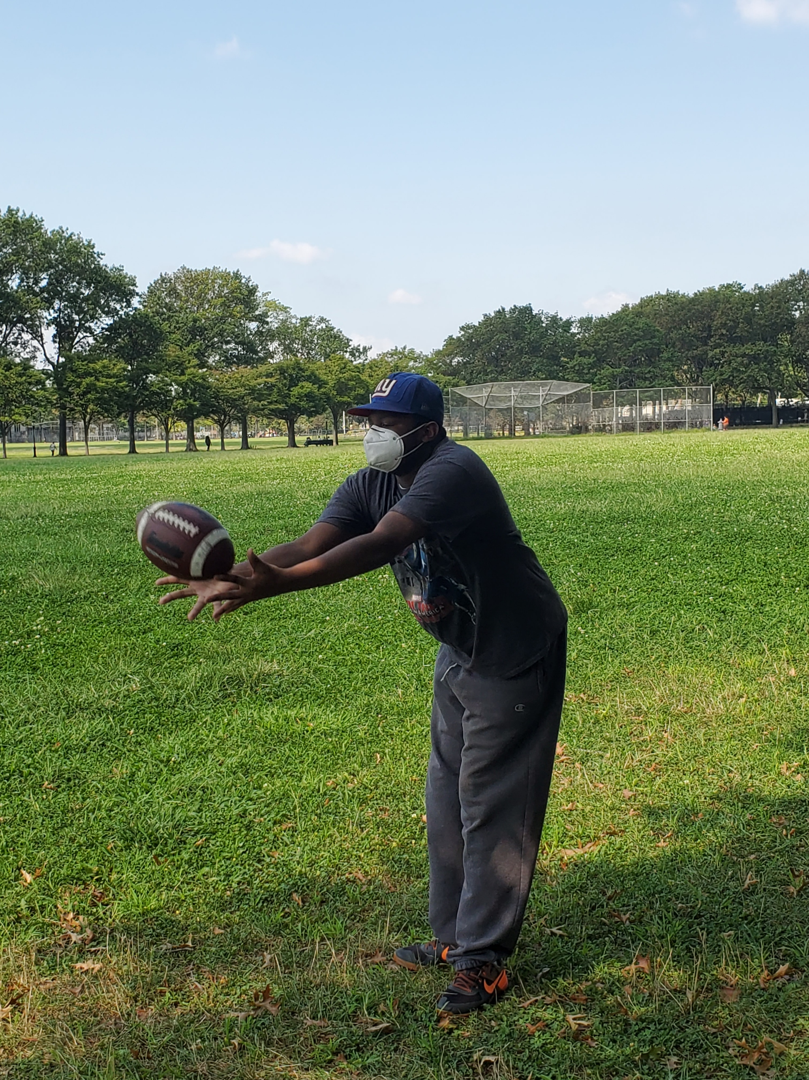
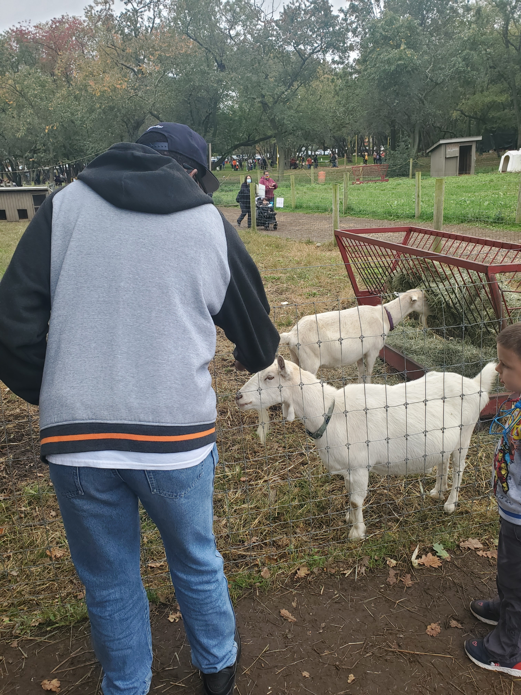
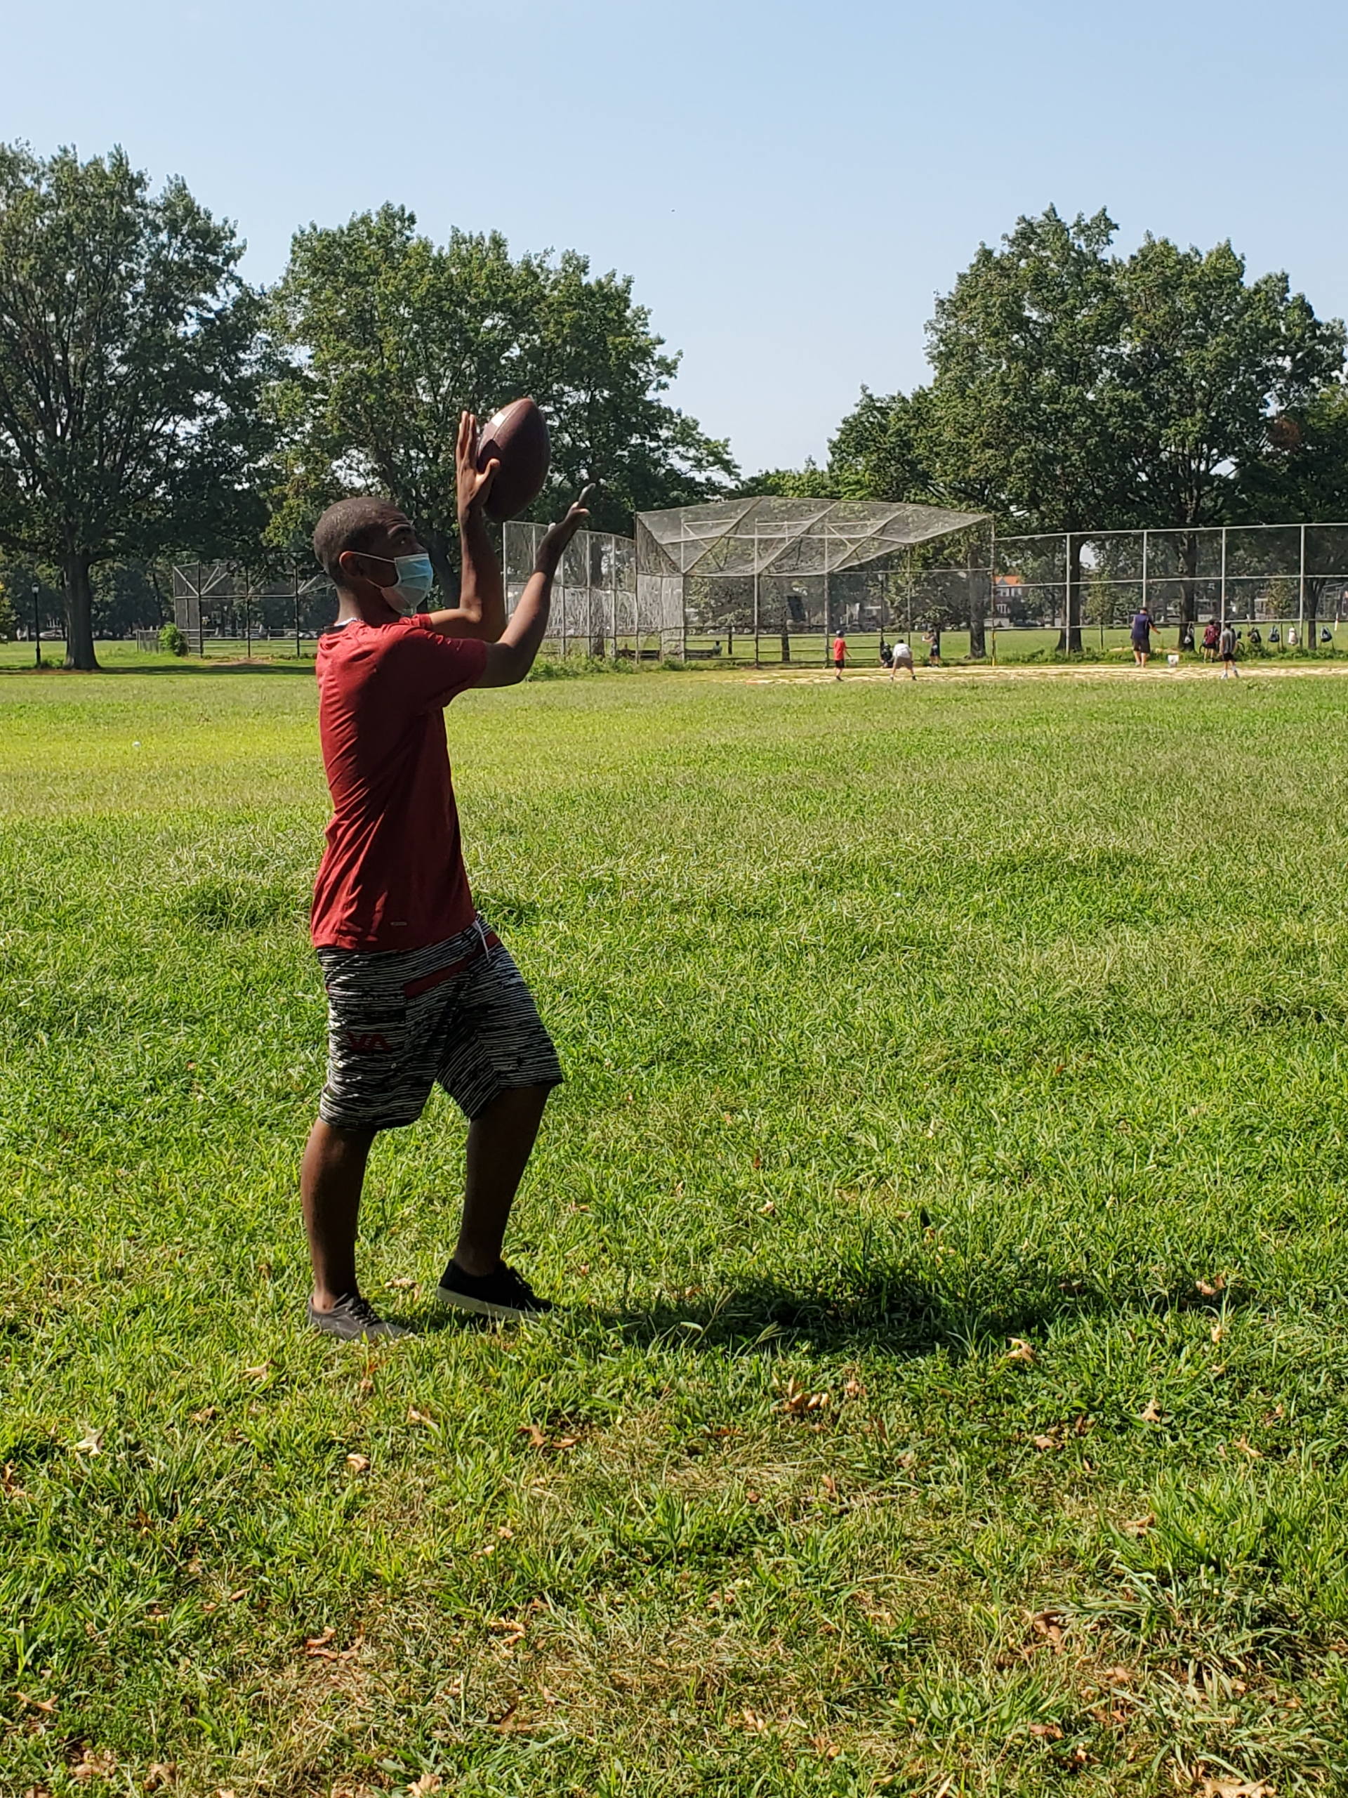
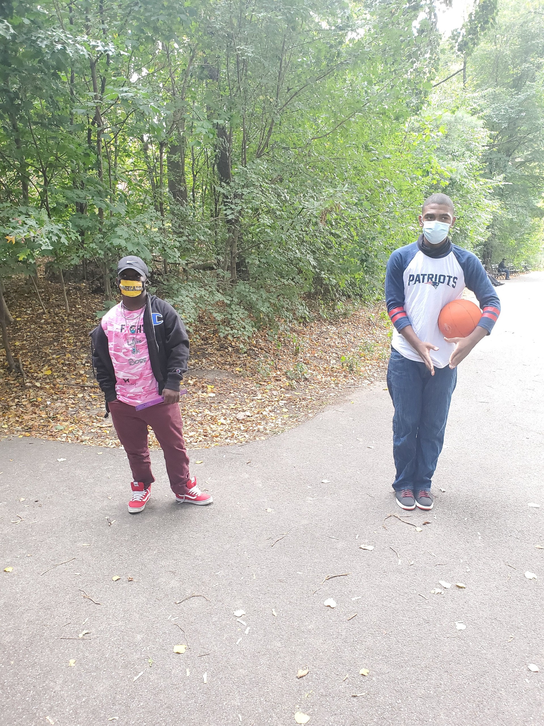
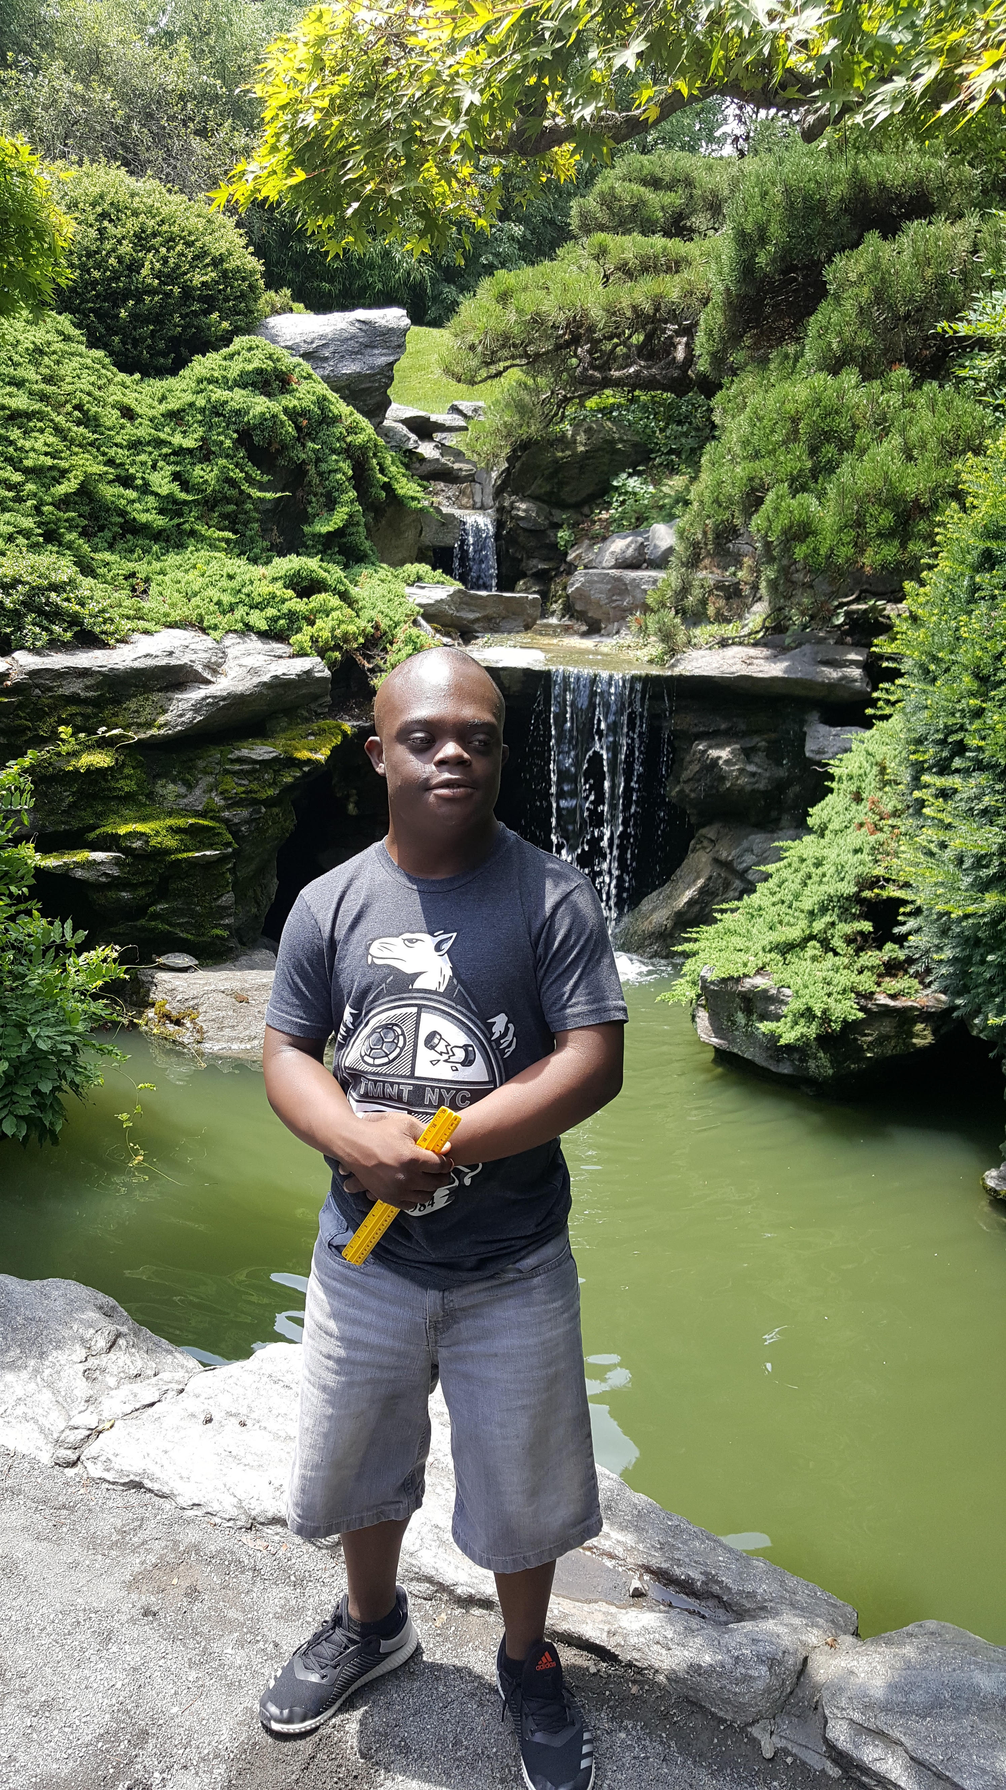
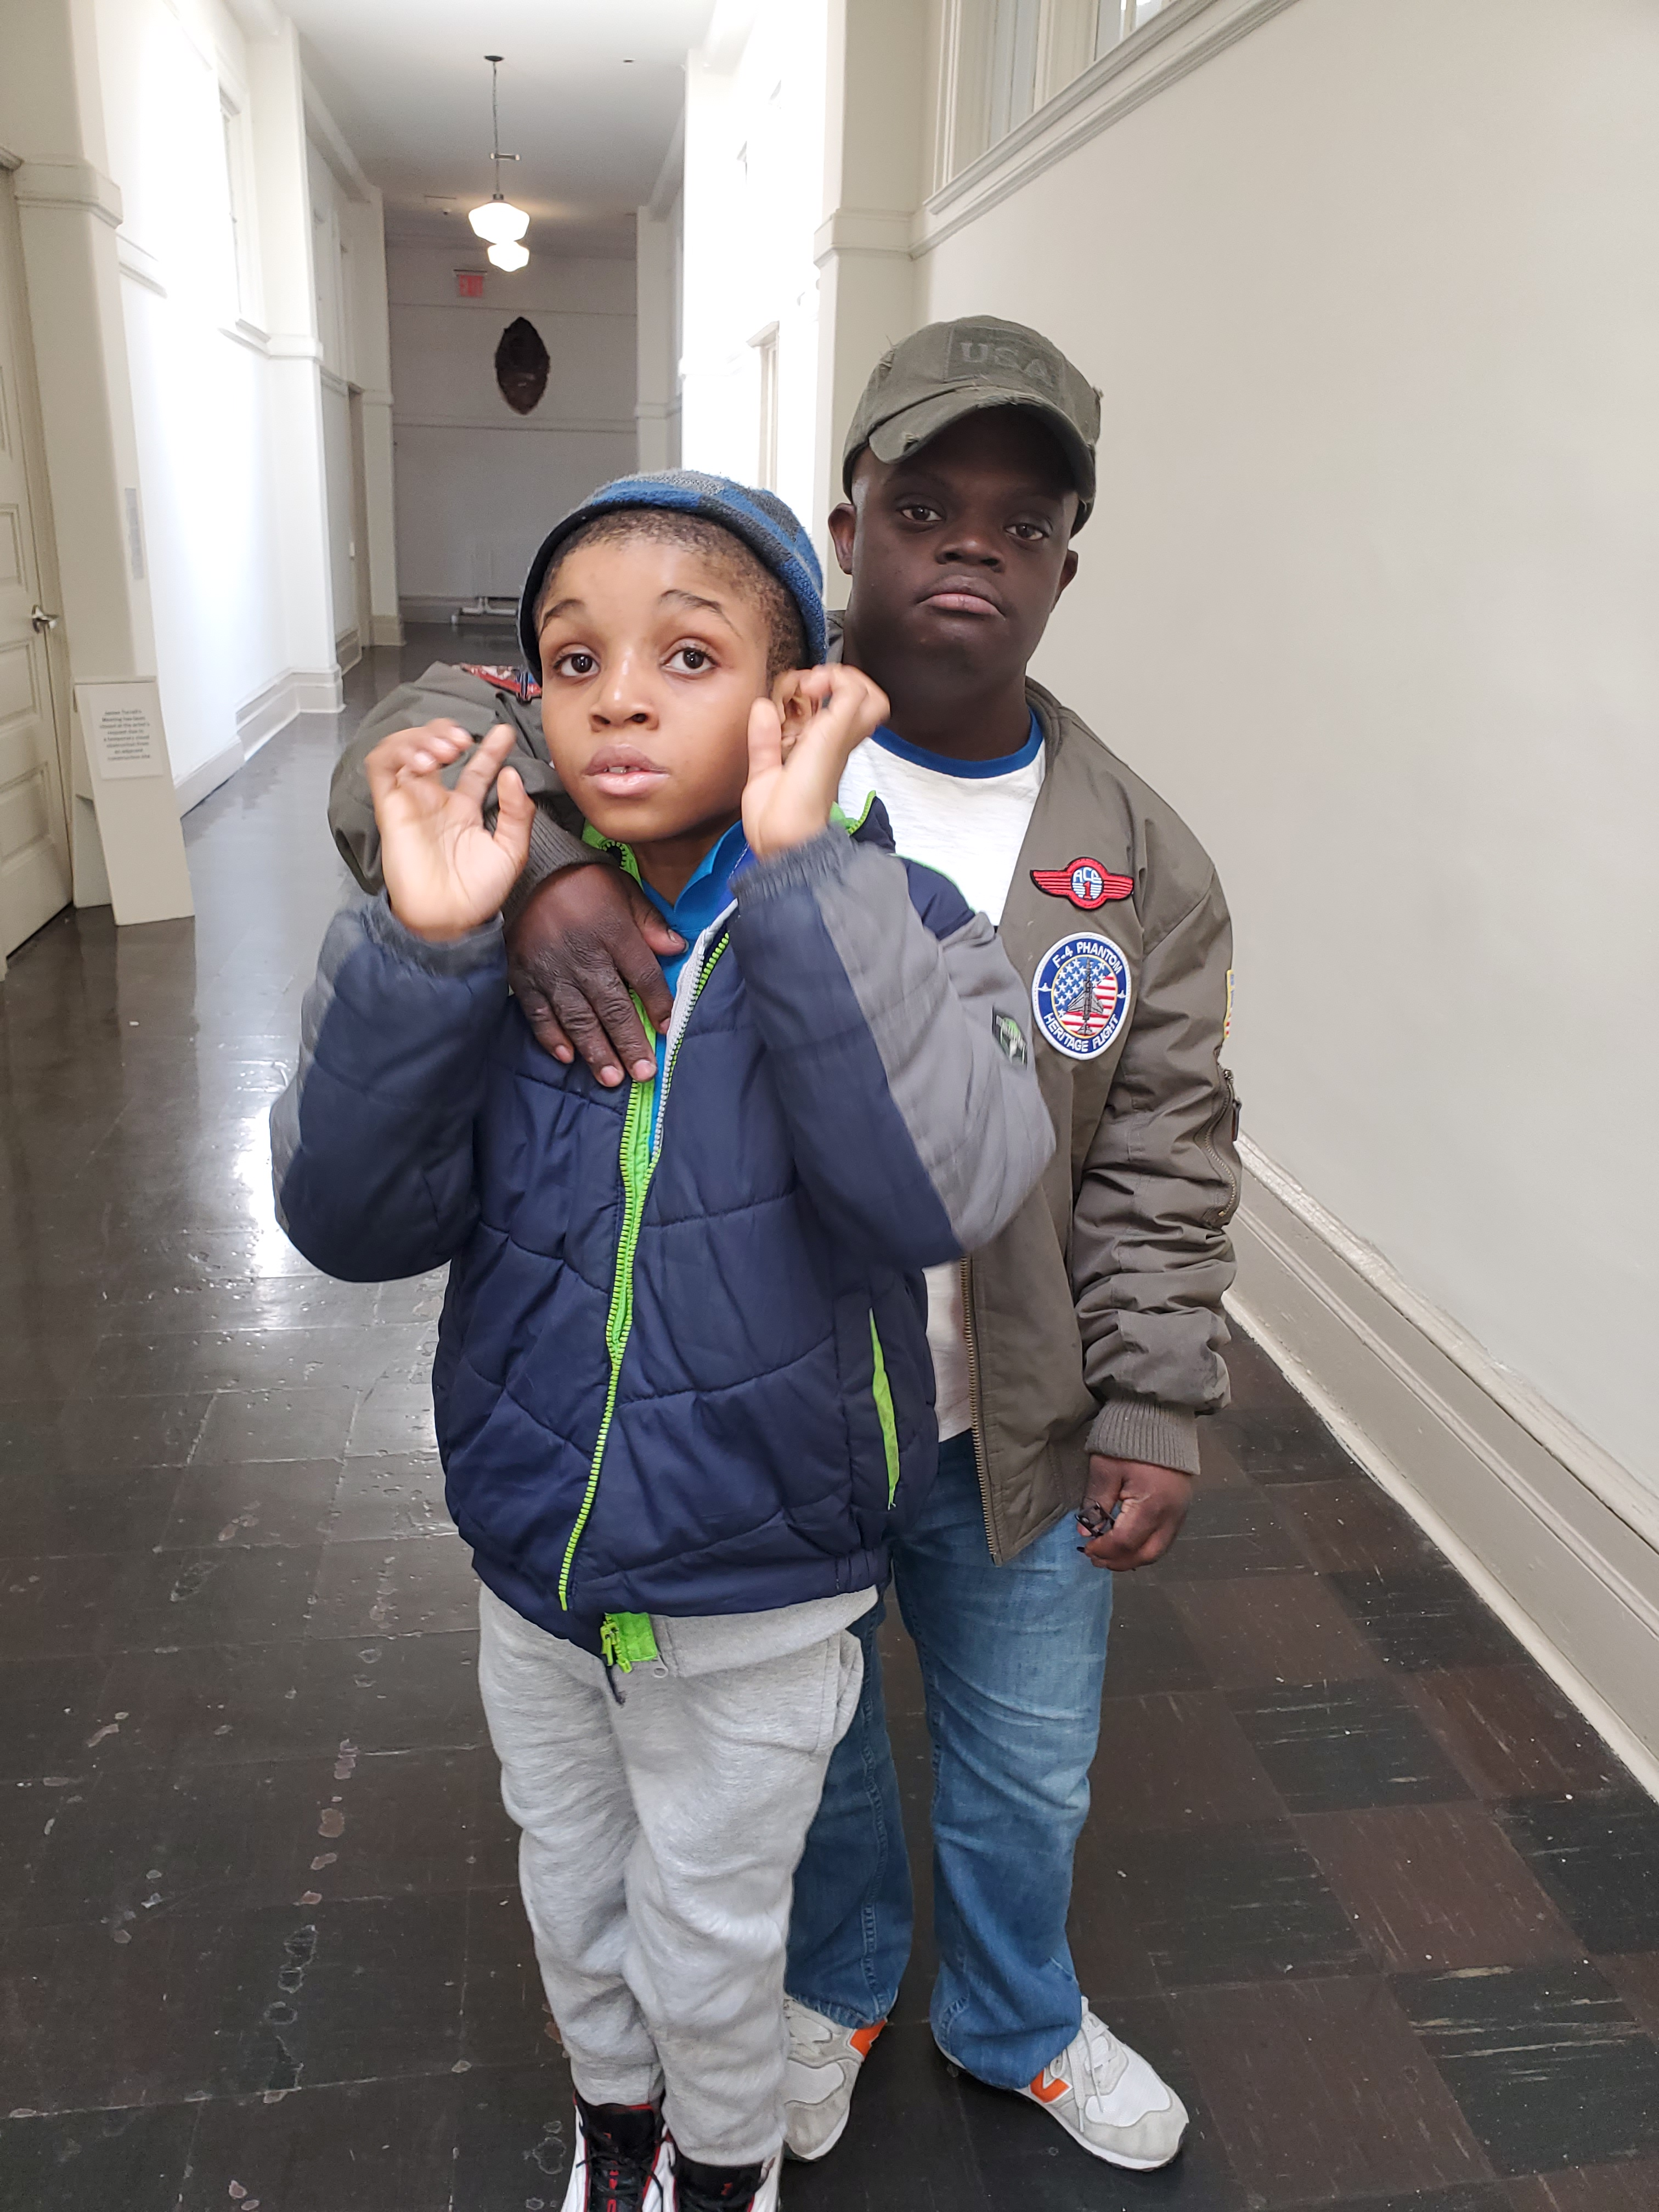
Creating Memories

Slide 6
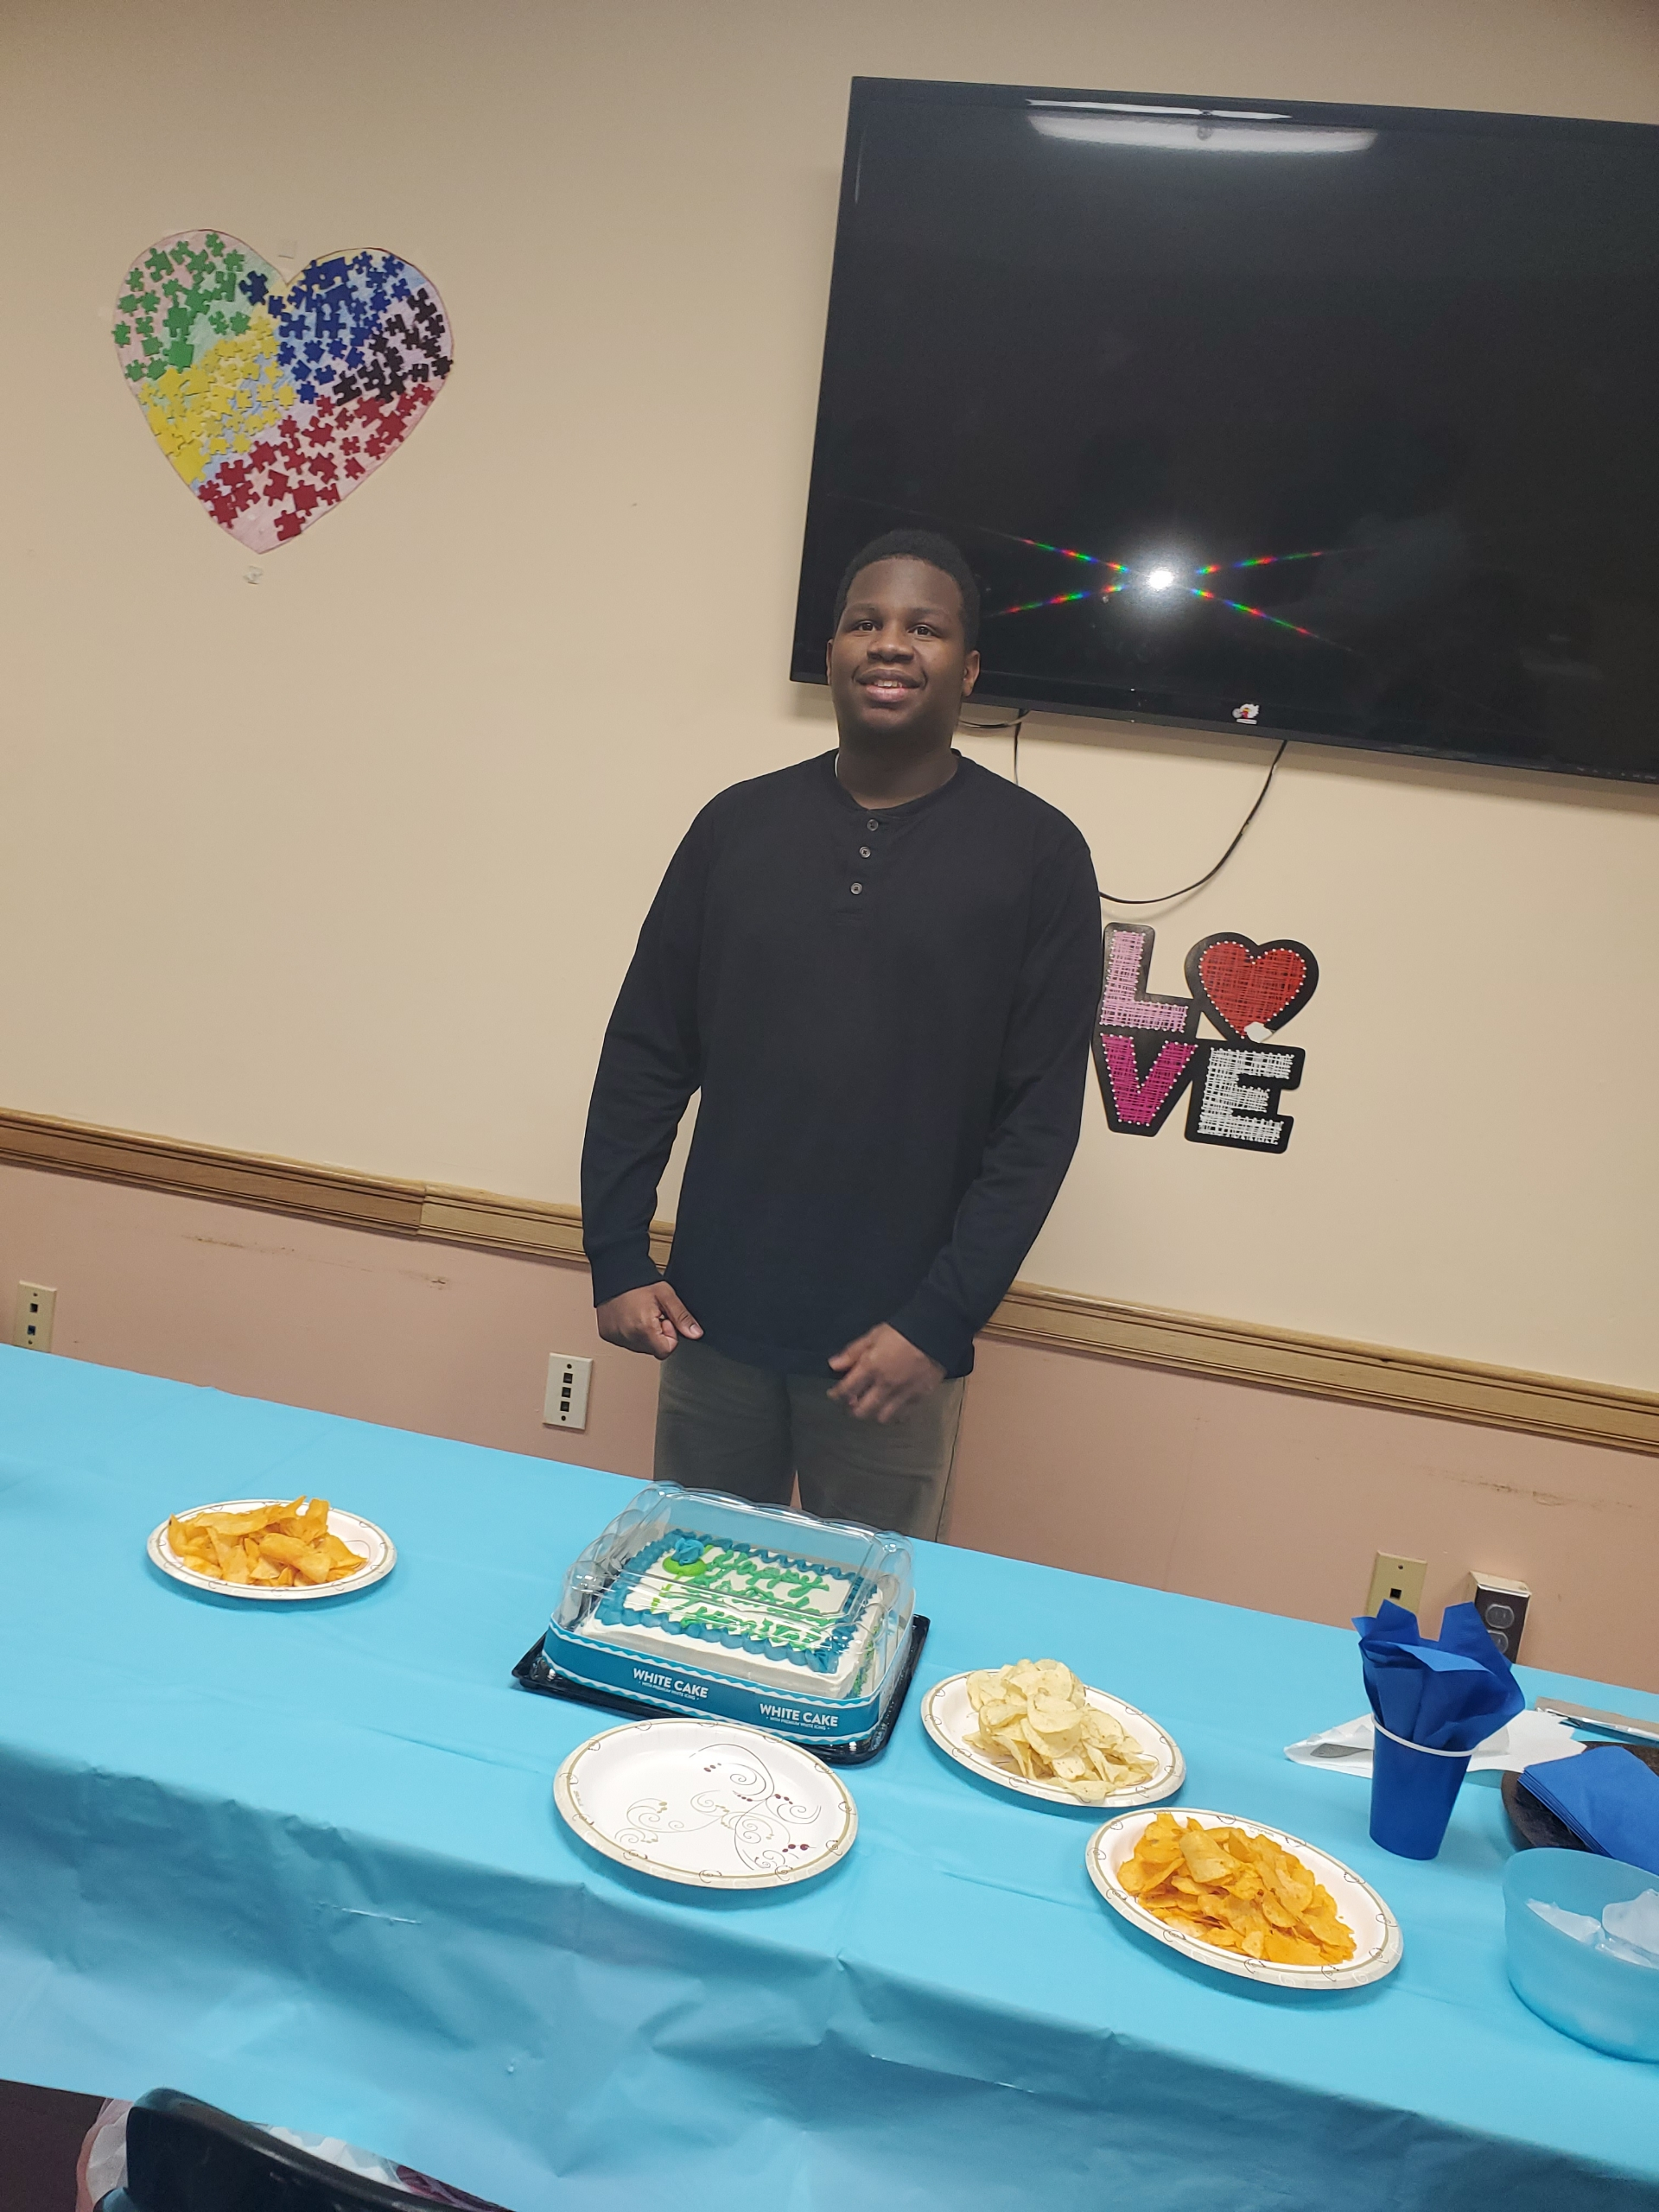
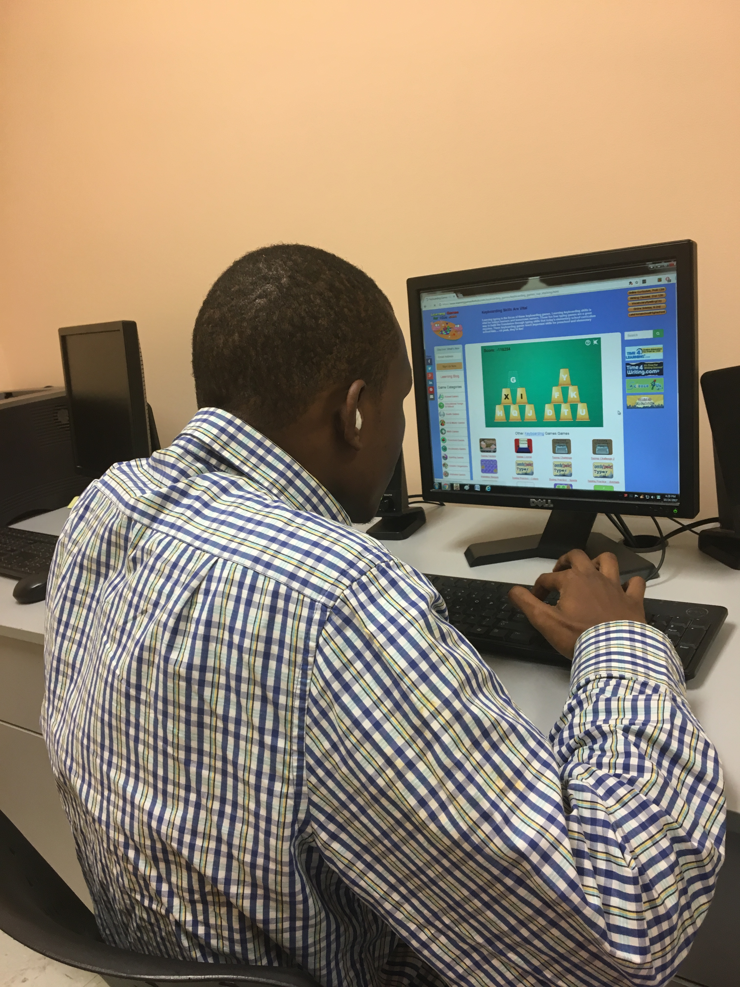
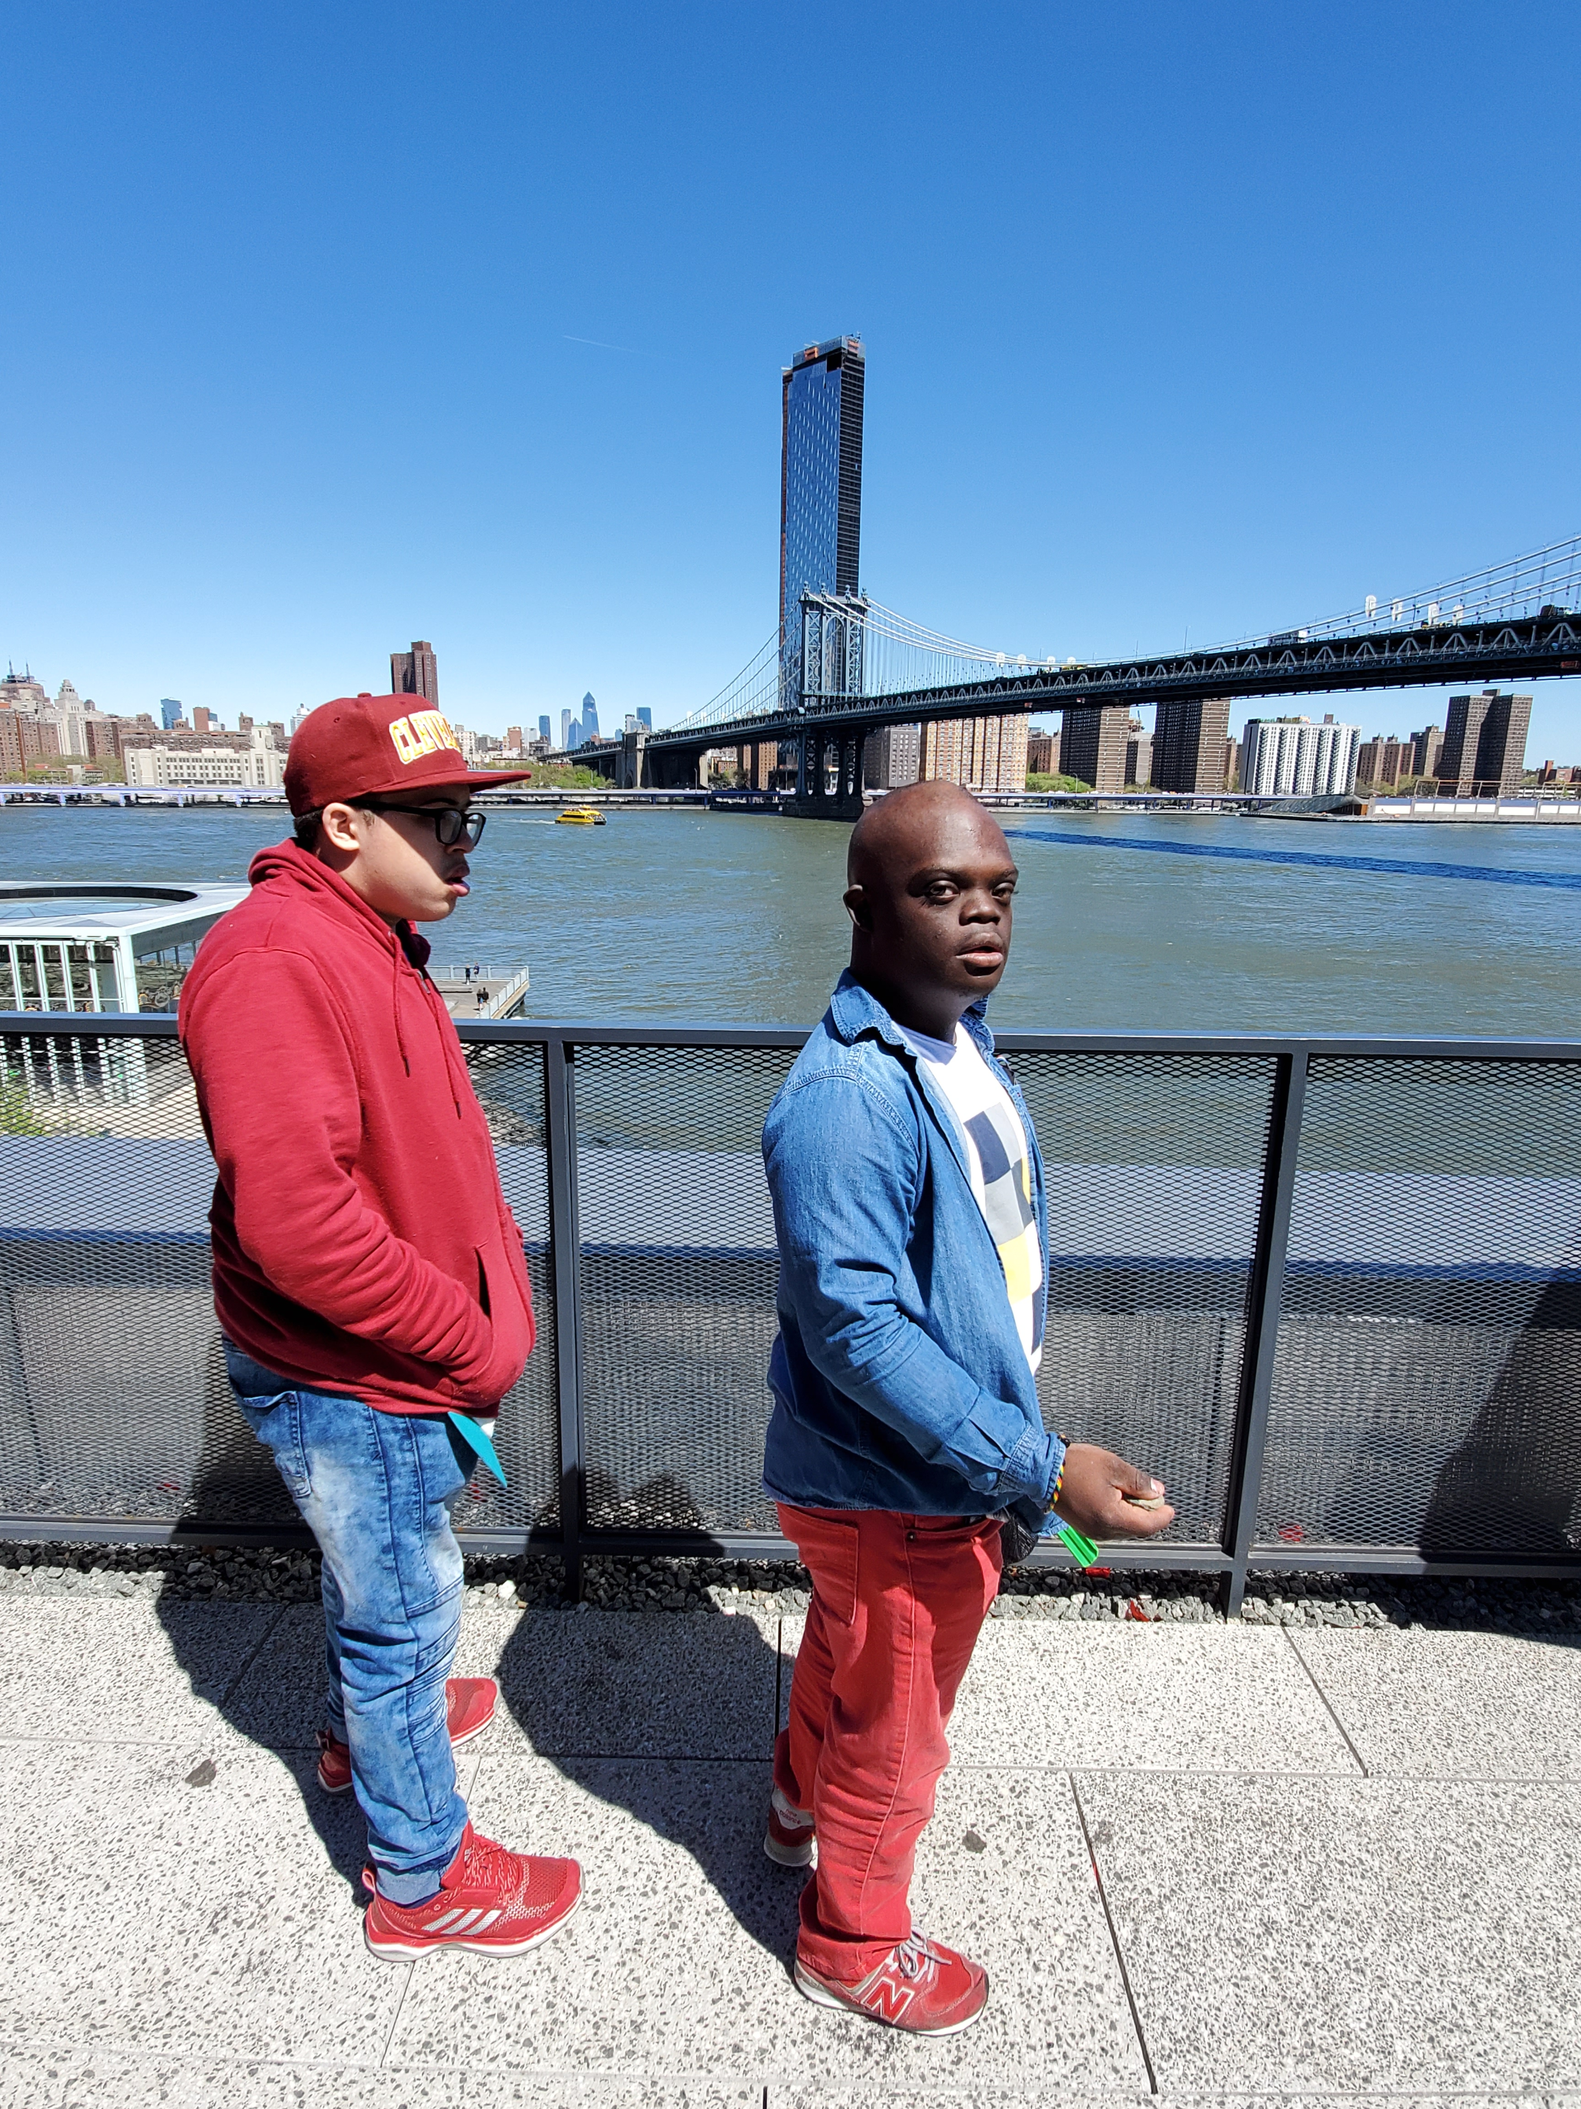
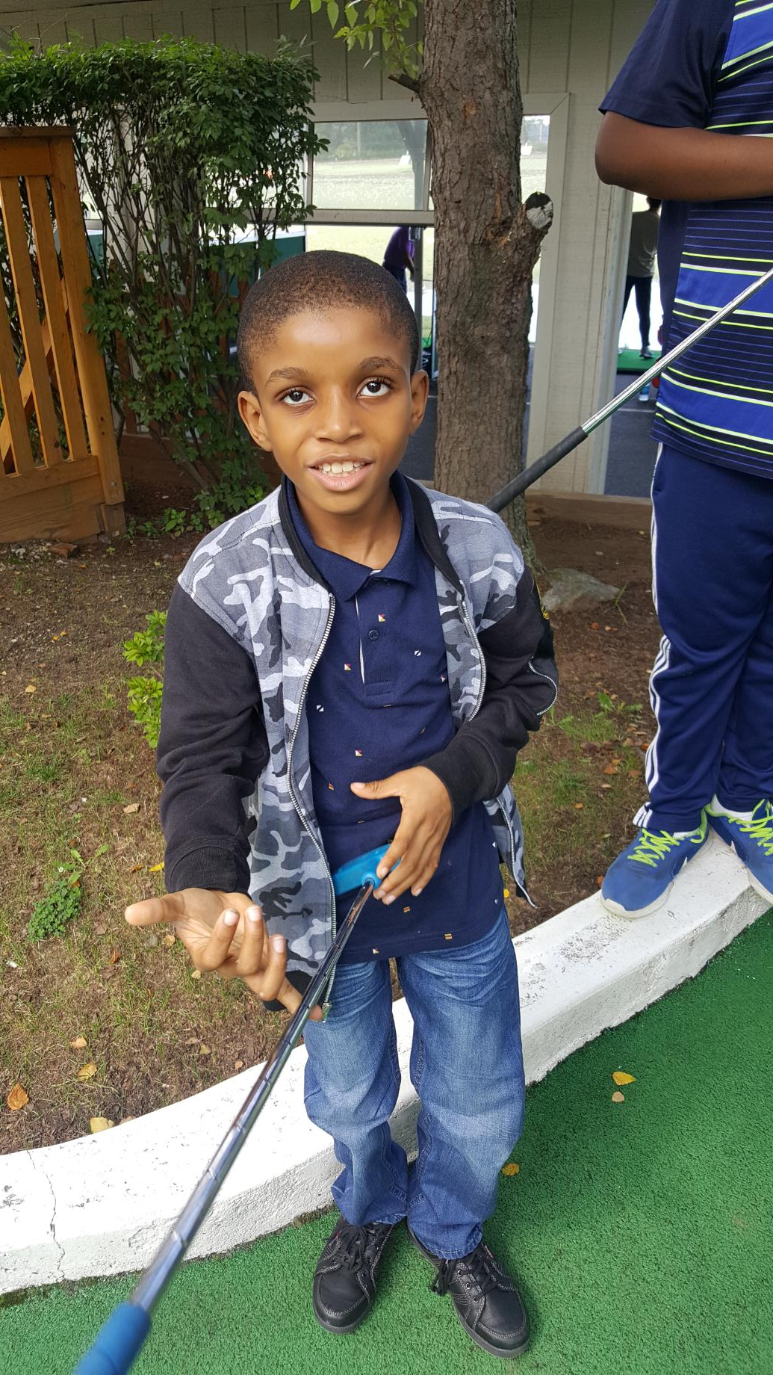
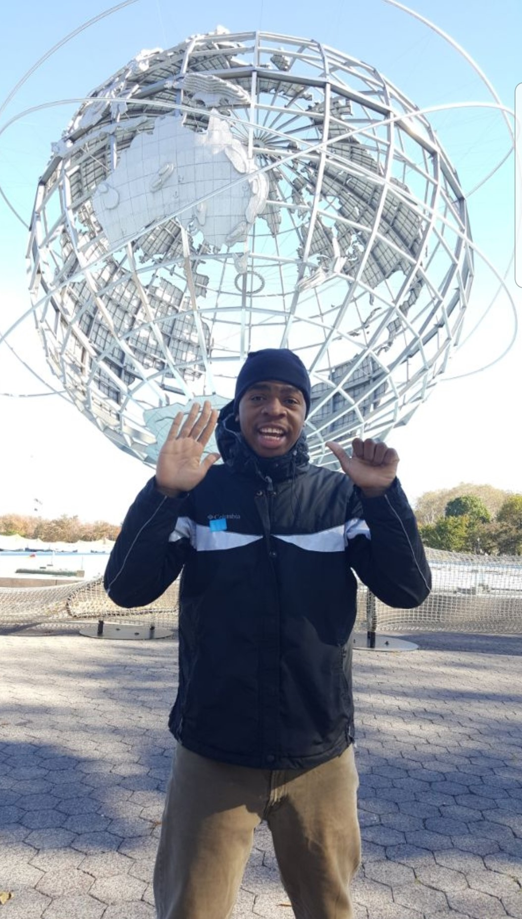
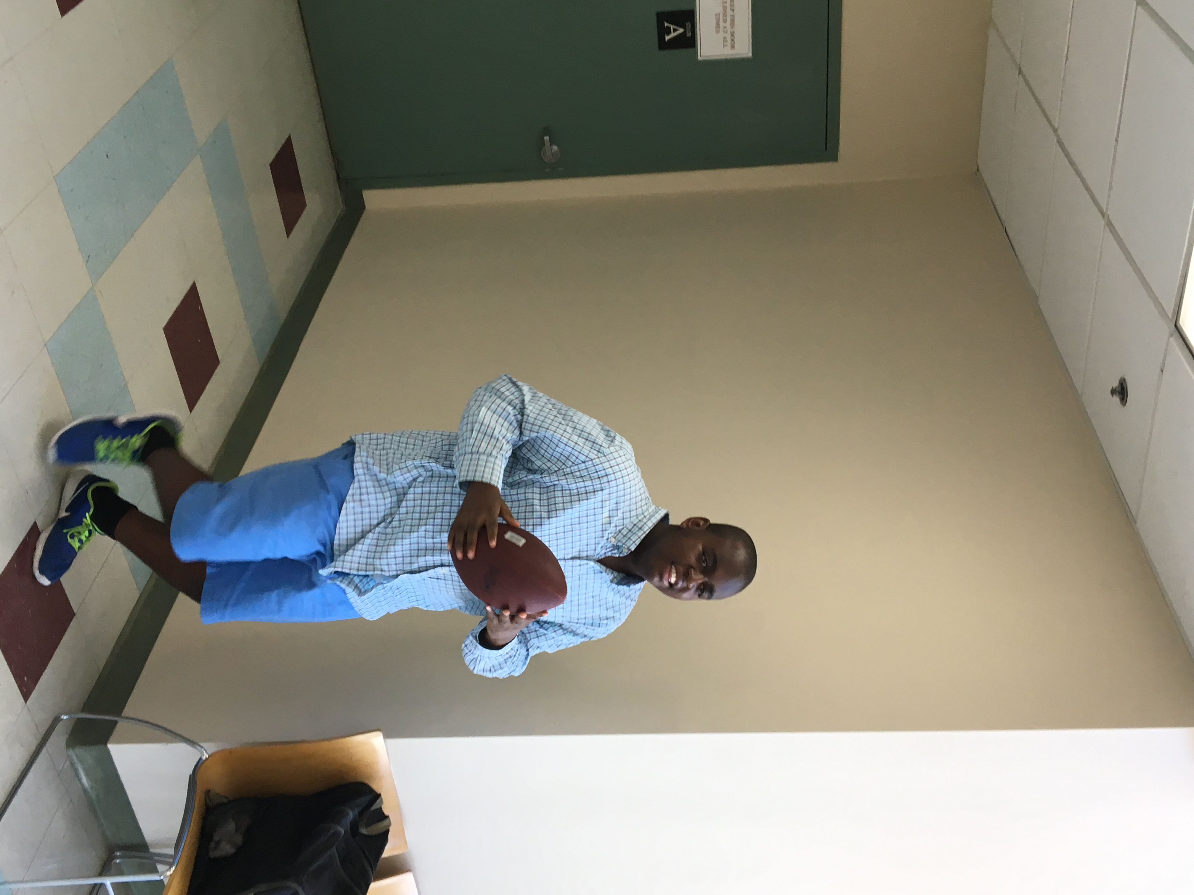
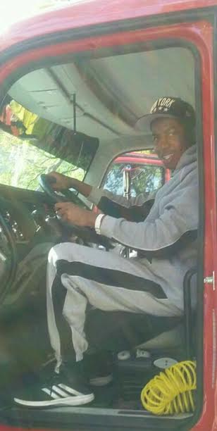
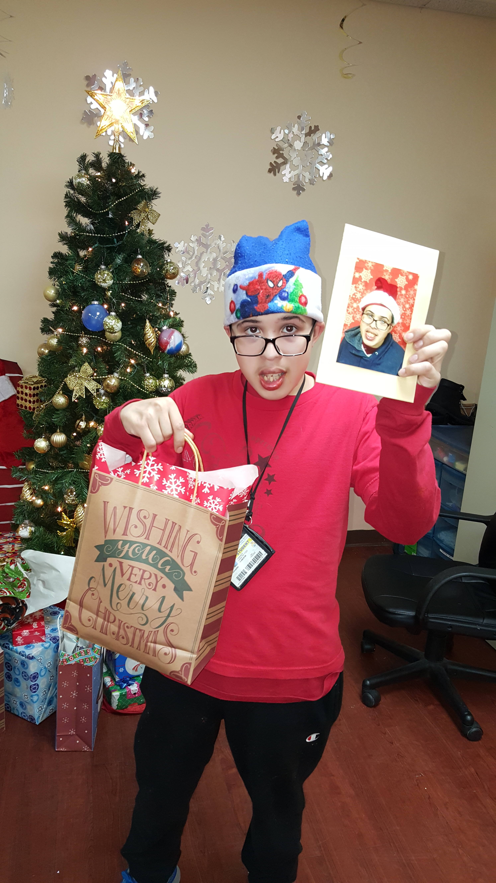
Enhancing The Lives
Of The Ones You Love

Slide 7
Safety First
Keeping your child safe in the
“new normal”
Temperature Checks
Social Distancing
PPE provided
Health and safety discussions

Slide 8
We’ve Gone Virtual !
Join us on Zoom

Slide 9
Virtual Activities
Bingo
Tie Dye Masks
Painting
DIY Baseball Hats
Karaoke
Name That Tune
Memory Match
Hang Man
Virtual Birthday Parties
DIY Tote Bags
DIY Slime
Virtual Field Trips
Matinee
Button Making
Scavenger Hunts
Fitness
Freeze Dance

Slide 10
Contact Information
8814 Foster Avenue
Brooklyn, New York 11236
Phone: 718-345-1119
Coordinator: Celestine Washington
Email: Cwashington@humanfirst.org
Website: http://www.humanfirst.org/

Slide 11
Thank You!
Heroes are hard at work to keep your loved ones safe.

